Slide 1


Analysing the
Impact
of
Car Features
on
Price
and Profitability

Slide 2





Slide 3

Business and Data Analytics Skills:

Slide 4
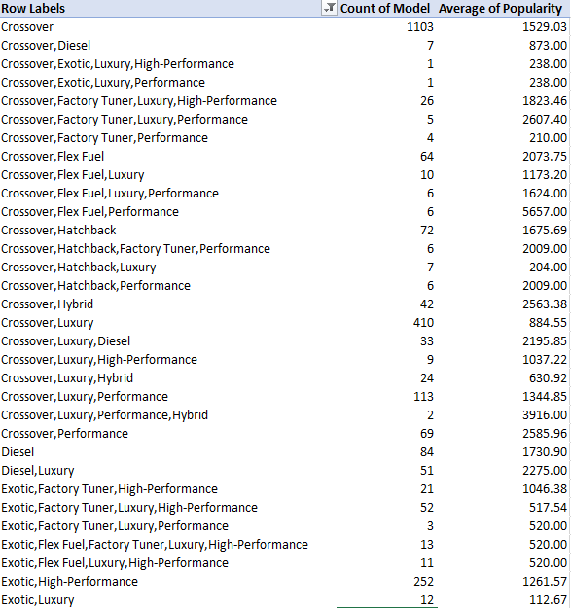
Business and Data Analytics Skills:
How does the popularity of a car model vary across different market categories?
Task 1.A: Create a pivot table that shows the number of car models in each market category and their corresponding popularity scores.

Slide 5
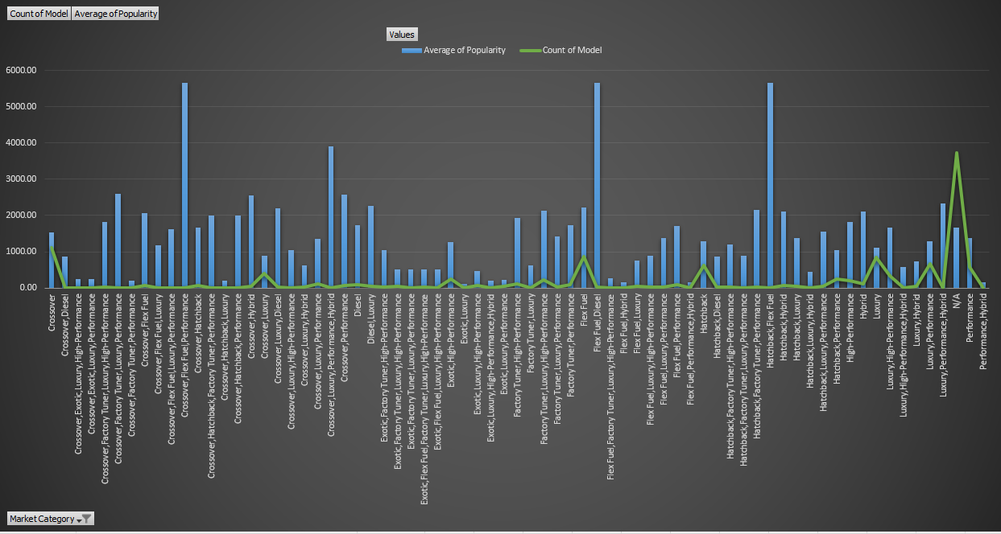
Task 1.B: Create a combo chart that visualizes the relationship between market category and popularity.

Slide 6

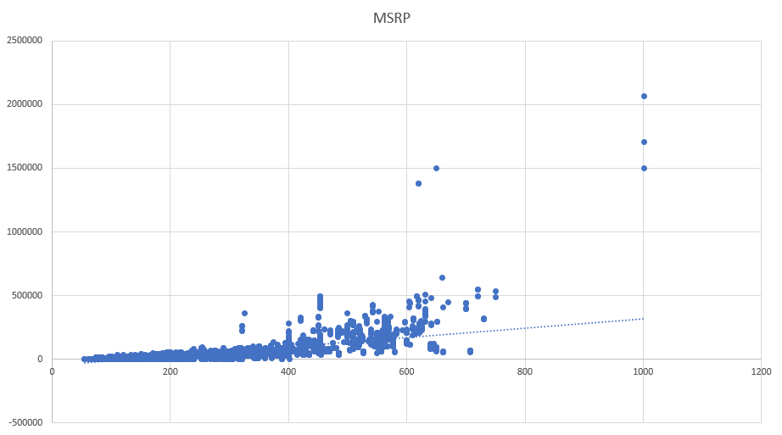
Insight Required: What is the relationship between a car's engine power and its price?
Task 2:
Create a scatter chart that plots engine power on the x-axis and price on the y-axis. Add a trendline to the chart to visualize the relationship between these variables.

Slide 7
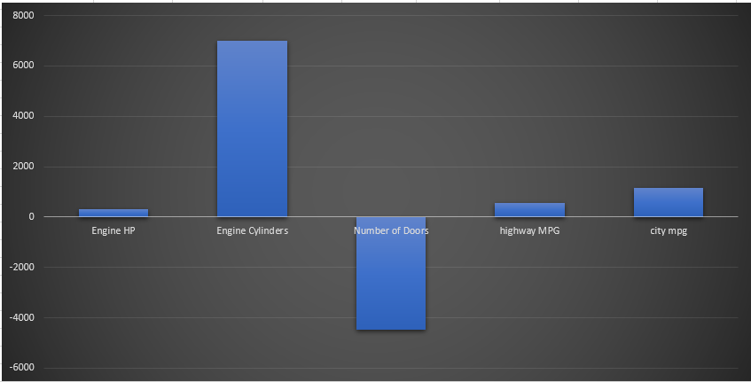
Insight Required: Which car features are most important in determining a car's price?
Task 3: Use regression analysis to identify the variables that have the strongest relationship with a car's price. Then create a bar chart that shows the coefficient values for each variable to visualize their relative importance.

Slide 8

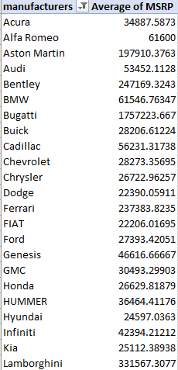
Insight Required: How does the average price of a car vary across different manufacturers?
Task 4.A: Create a pivot table that shows the average price of cars for each manufacturer.

Slide 9
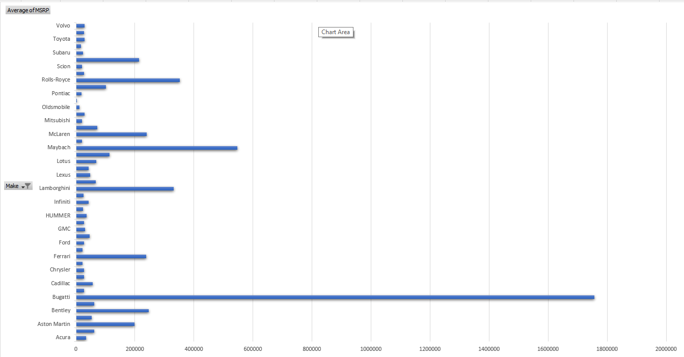
Task 4.B: Create a bar chart or a horizontal stacked bar chart that visualizes the relationship between manufacturer and average price.

Slide 10
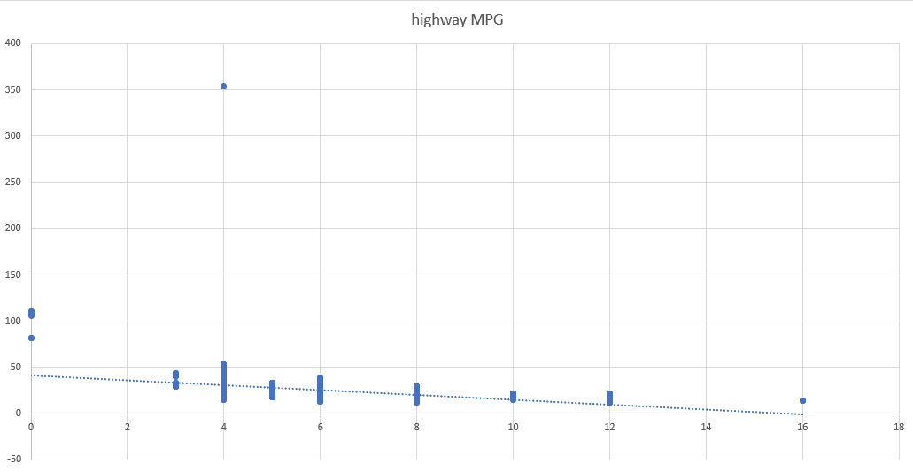
Insight Required: What is the relationship between fuel efficiency and the number of cylinders in a car's engine?
Task 5.A: Create a scatter plot with the number of cylinders on the x-axis and highway MPG on the y-axis. Then create a trendline on the scatter plot to visually

Slide 11
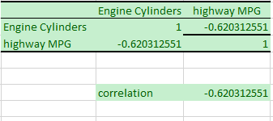
Task 5.B: Calculate the correlation coefficient between the number of cylinders and highway MPG to quantify the strength and direction of the relationship.
=CORREL(A1:A11813,B1:B11813)

Slide 12

Building the Dashboard:

Slide 13

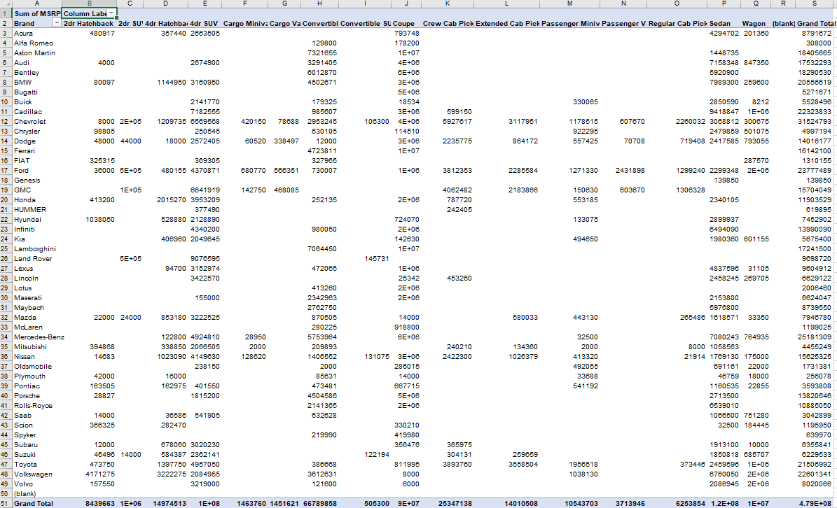
Building the Dashboard:
Task 1: How does the distribution of car prices vary by brand and body style?

Slide 14
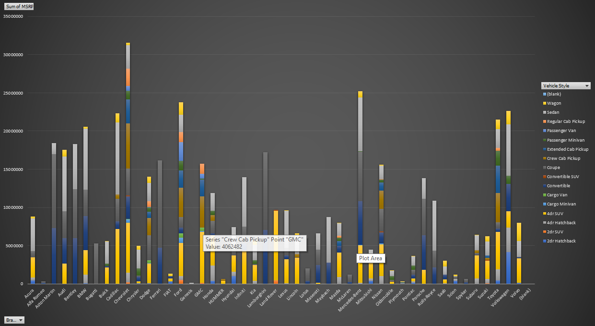

Slide 15
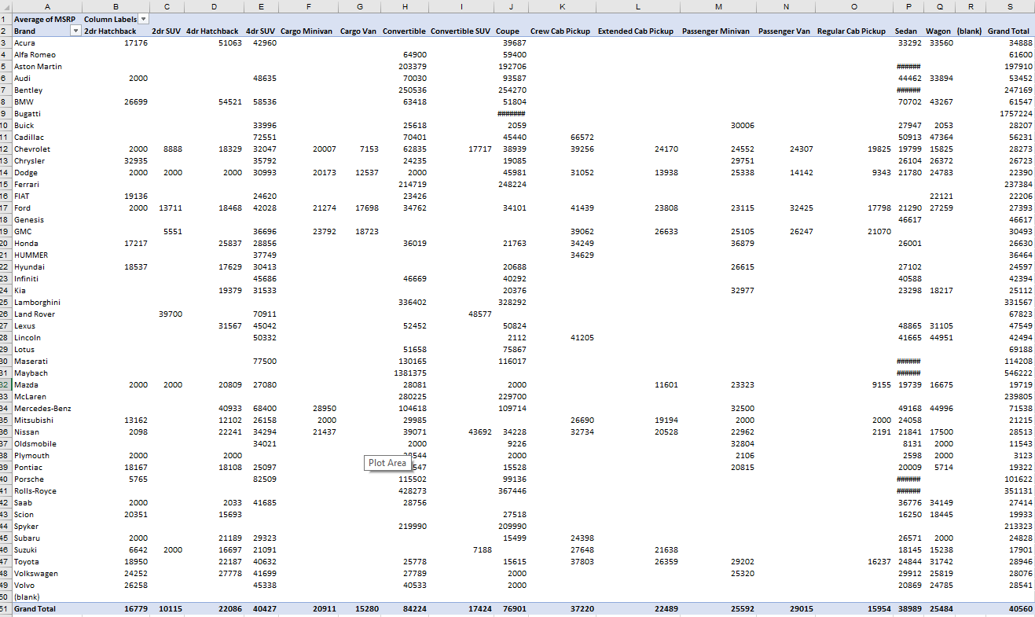
Task 2: Which car brands have the highest and lowest average MSRPs, and how does this vary by body style?

Slide 16
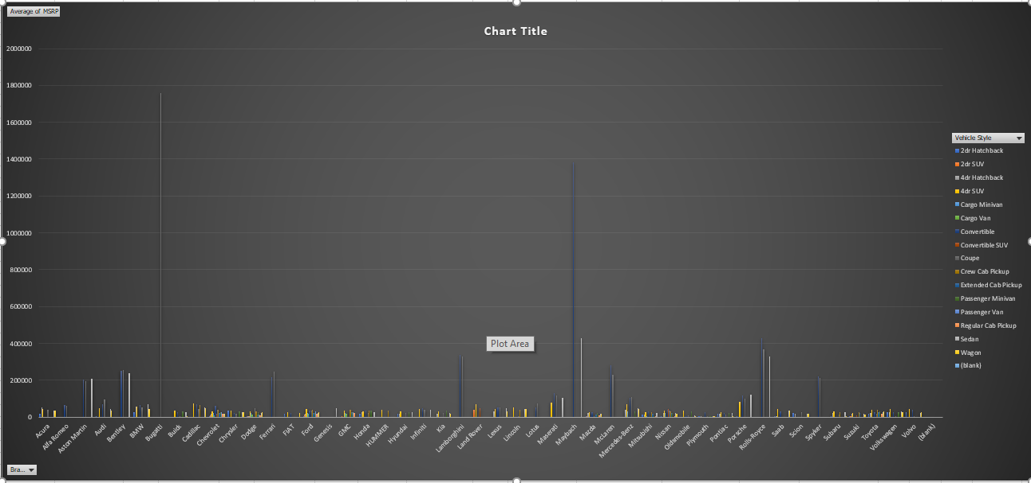

Slide 17
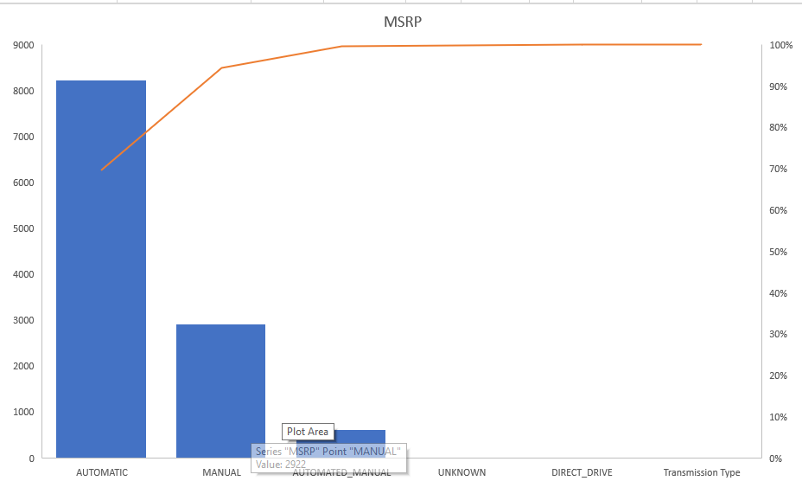
Task 3: How do the different feature such as transmission type affect the MSRP, and how does this vary by body style?

Slide 18
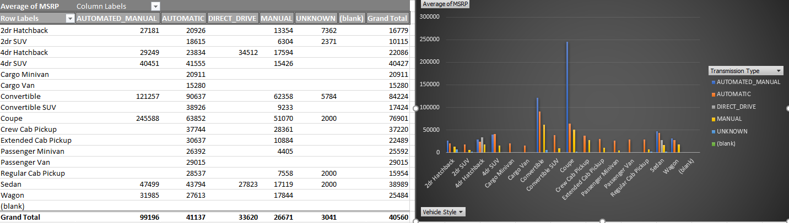

Slide 19
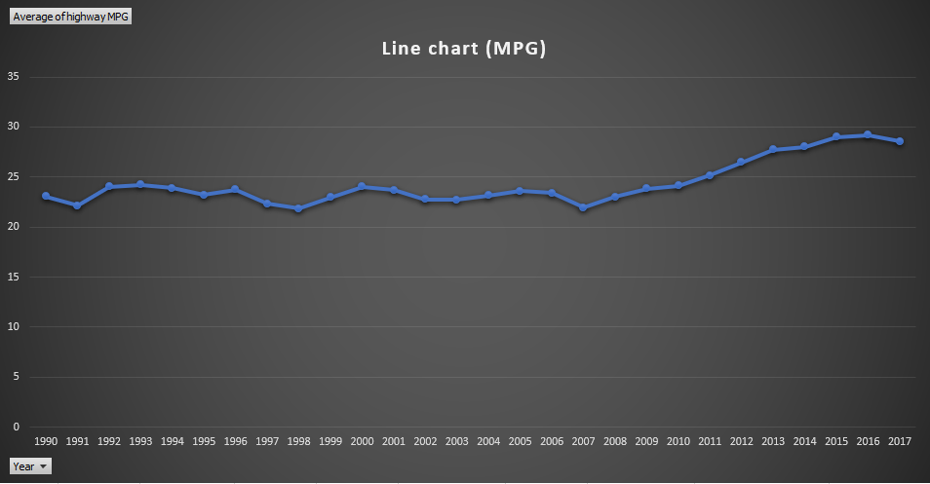
Task 4: How does the fuel efficiency of cars vary across different body styles and model years?

Slide 20
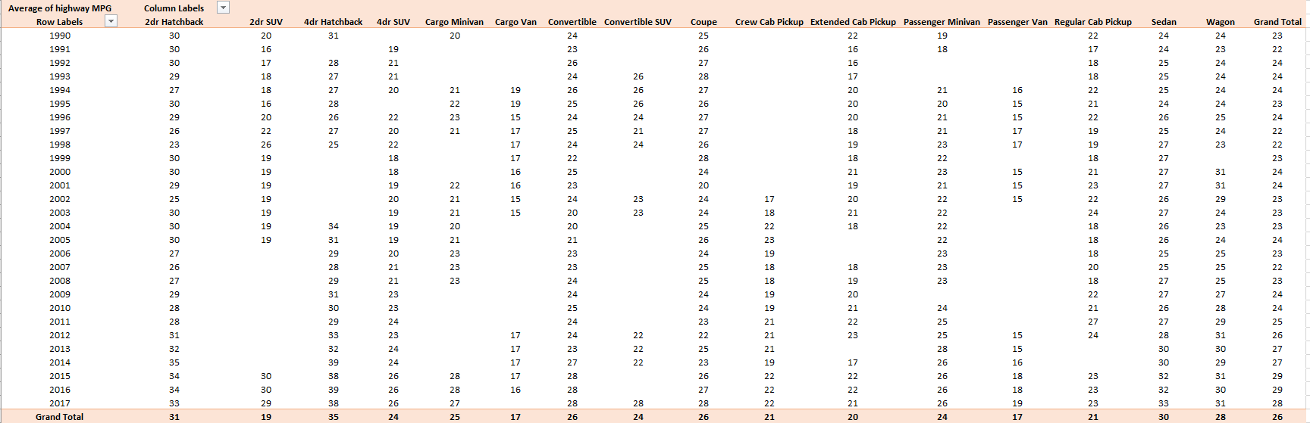

Slide 21
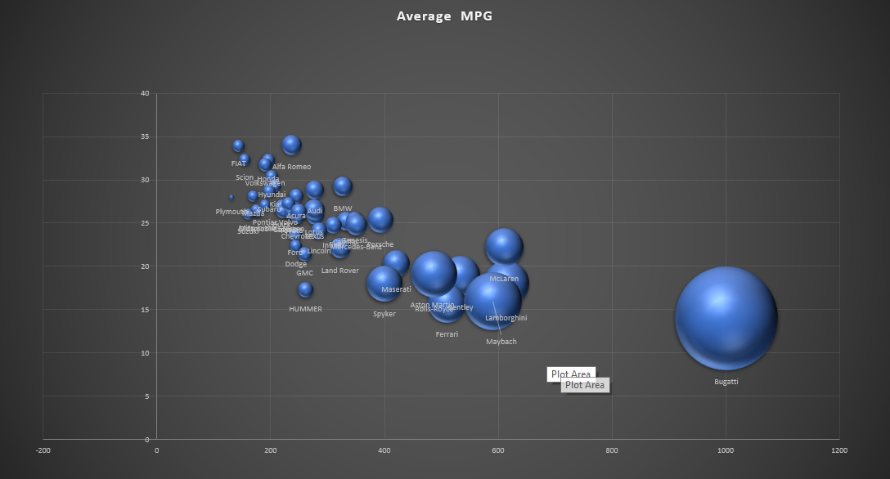
Task 5: How does the car's horsepower, MPG, and price vary across different Brands?

Slide 22
Conclusion
Description: In this project, we aim to help automotive manufacturers optimize their pricing and product development strategies to enhance profitability while meeting consumer demand. By analyzing a comprehensive dataset encompassing various car features, market categories, pricing, and profitability metrics
Result:
Through data analysis, it identifies popular car features, quantifies their impact on pricing and profitability, and recommends optimal pricing strategies. These insights empower manufacturers to maximize profitability while meeting consumer demand effectively.

Slide 23
Thank you
Suraj Kumar

